Slide 1
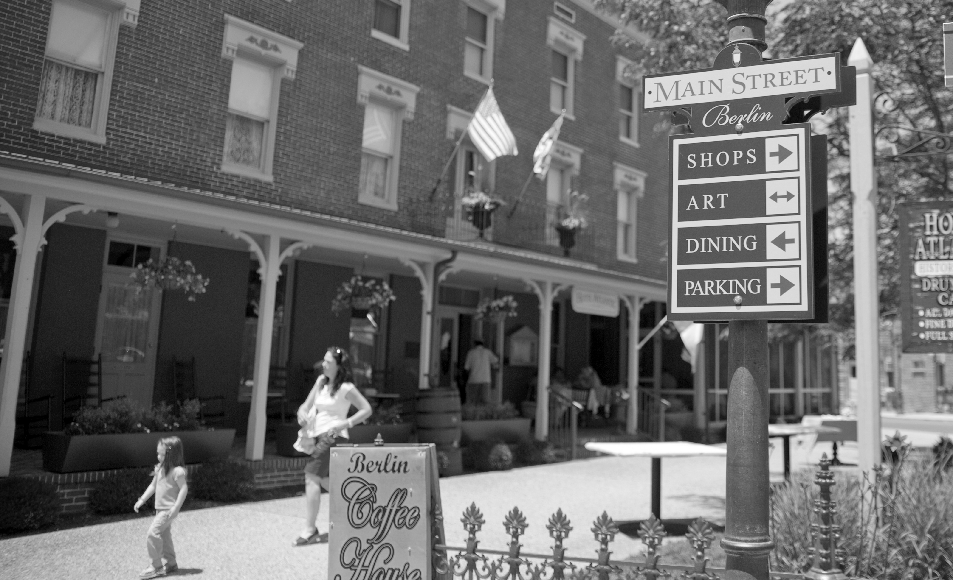
MD DHCD Homelessness Solutions Team
Maryland Department of Housing and Community Development
Secretary Kenneth C. Holt
June 2020

Slide 2
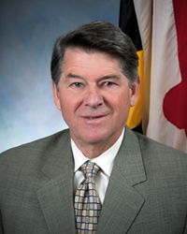
Secretary Kenneth C. Holt
Office of the Secretary
Community Development Administration
Neighborhood Revitalization
Division of Credit Assurance / Maryland Housing Fund
Maryland Affordable Housing Trust
Division of Finance
Notes:
MD DHCD is one of 23 agencies that comprise the Governor’s Cabinet

Slide 3
Secretary Kenneth C. Holt
Office of the Secretary
Community Development Administration
Neighborhood Revitalization
Division of Credit Assurance / Maryland Housing Fund
Maryland Affordable Housing Trust
Division of Finance
Notes:
MD DHCD is one of 23 agencies that comprise the Governor’s Cabinet

Slide 4
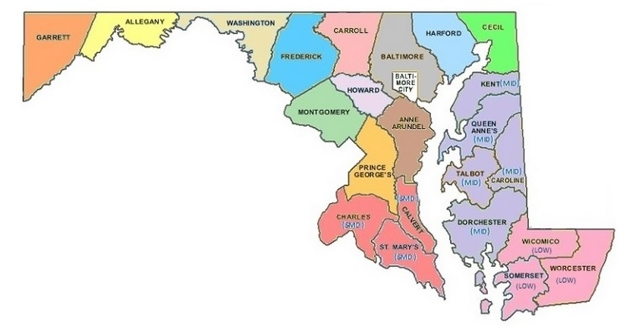
Homelessness Solutions Program (HSP)
16 CoCs with five currently transitioning as part of Balance of State
Notes:
Within NR, the Homelessness Solutions Team administers MD’s Homelessness Solutions Program, the federal ESG program to non-entitlement jurisdictions (what is entitlement v non), provides coordination/facilitation of the MD Interagency Council on Homelessness, and most recently, is the lead agency for the newly formed MD Balance of State CoC

Slide 5
Homelessness Solutions Program (HSP)
Outreach
Emergency Shelter
Housing Stabilization (Prevention / Rapid Re-housing)
HMIS
Notes:
Beginning in 2017, HSP is a single source of funds for CoCs from five sources (Rental Assistance Program; Homelessness Prevention Program; Housing Counselor and Aftercare Program; Crisis Shelter Home Program; and Service Linked Housing Program)

Slide 6
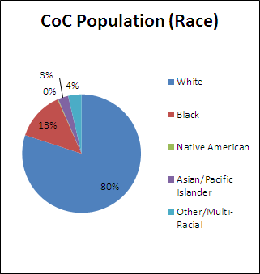
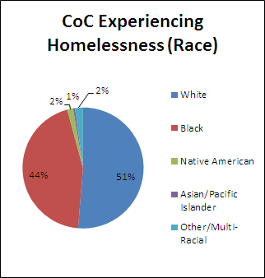
Racial Disparity
Notes:
Across the country beginning in ~2017/18 more intentional discussions about racial disparities within homeless systems were happening at the national level. To facilitate these conversations at the community level, HUD published aggregated racial data from PIT and HMIS data and made it publicly available. In support of this focus, DHCD reviewed and synthesized this data for each of the CoCs. Here are the findings for Harford.
While representing only 13% of the overall population in Harford County, 44% percent of the population experiencing homelessness identified as Black. A 31 point increase from the overall population
While representing 80% of the overall population of Harford County, 51% of the people experiencing homelessness identified as White. A 29 point decrease.
Similar results are found in the specific subgroups (families & youth).

Slide 7
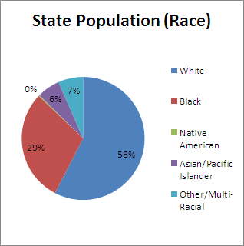
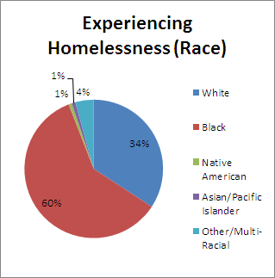
Racial Disparity
Notes:
This disparity is seen across the state.

Slide 8
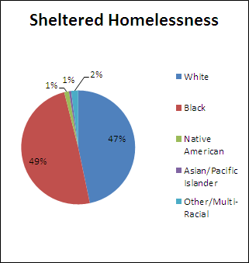
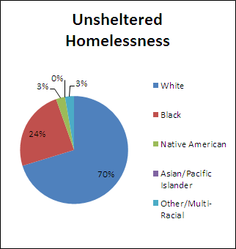
Racial Disparity
Notes:
When comparing the sheltered and unsheltered counts, there is less of a disparity present in the unsheltered population for those identifying as Black or White.
This discrepancy is not present in the veteran subgroup.

Slide 9
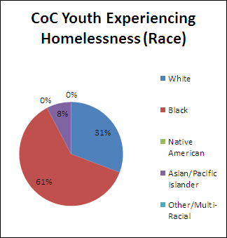
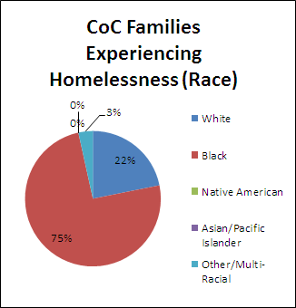
Racial Disparity
Notes:
Disparities are exacerbated in the Youth and Families subcategories of the population experiencing homelessness for those identifying as Black or White.
For example, Black families make up 75% of the families experiencing homelessness compared to 44% of all people experiencing homelessness identifying as Black.

Slide 10
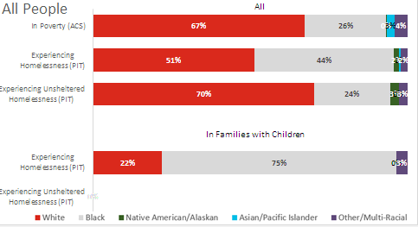
Racial Disparity
Notes:
Even when looking at poverty rates, Blacks show up more in the homeless system, indicating that this is not a matter of poverty.

Slide 11
Racial Disparity
Notes:
Even when looking at poverty rates, Blacks show up more in the homeless system, indicating that this is not a matter of poverty.

Slide 12
Racial Disparity
Notes:
Even when looking at poverty rates, Blacks show up more in the homeless system, indicating that this is not a matter of poverty.

Slide 13
Racial Disparity
Notes:
Even when looking at poverty rates, Blacks show up more in the homeless system, indicating that this is not a matter of poverty.

Slide 14
Racial Disparity
Notes:
Even when looking at poverty rates, Blacks show up more in the homeless system, indicating that this is not a matter of poverty.

Slide 15
Racial Disparity
Where do we go from here?
What are other available data sources?
How can this information be integrated with other data to give as holistic a picture as possible?
Who else needs to see and understand this data?
What can MD DHCD do to support you in this work?
Notes:
What racial data do we have / can we get from HMIS in terms of ES, HP, RRH entry, placements, and LOS? How is race addressed in client assessment?
How ensure that all parts of the CoC are intentionally and consistently focusing on racial disparity / racial equity as a part of their work?
How can this information be used to address other challenges (e.g. lack of available and affordable housing)? Frame the need to increased access to housing as a racial equity issue now that we have the data to show it.

Slide 16
THANK YOU FOR WHAT YOU DO!
YOUR WORK MATTERS AND MAKES A DIFFERENCE
WE ARE HERE TO SUPPORT YOU
Elisha Harig-Blaine
Program Manager, MD DHCD
elisha.harig-blaine@maryland.gov

